Slide 1
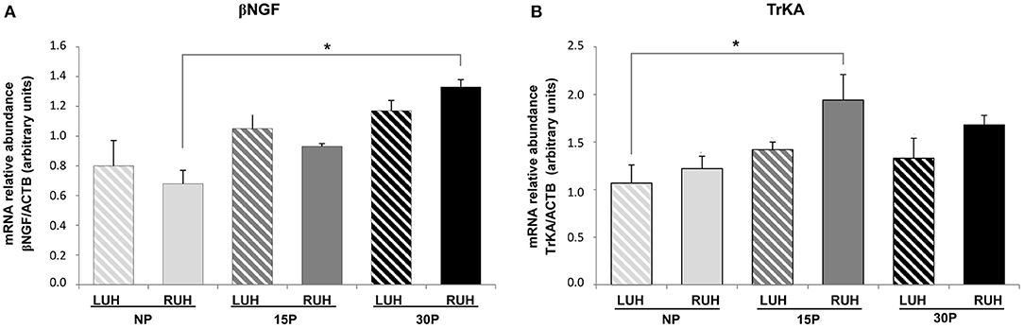
Good:
Showing abundance of 2 different transcriptomes in non-pregnant vs pregnant alpacas at varying time points of pregnancy for either left or right uterine horn

Slide 2
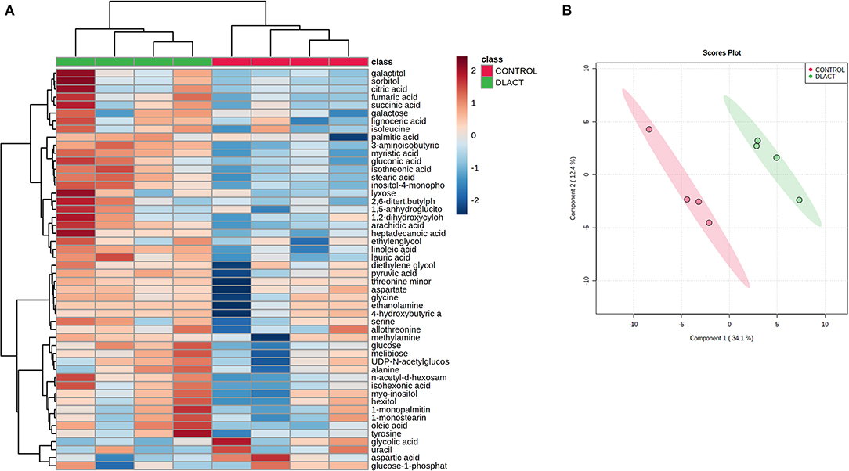
Ugly:
Metabolomic profile of bovine fibroblast-like synoviocytes after D-lactate treatment. (A) Hierarchical clustering analysis of 50 metabolites from the control untreated and D-lactate-stimulated synoviocytes. The red and blue colors indicate that the metabolite level is increased and decreased compared to the mean metabolite relative abundance, respectively. Each column represents a sample clustered according to treatment, and each row represents an individual metabolite. n = 4. (B) The partial least squares-discriminant analysis (PLS-DA) score plot based on metabolomic analysis of D-lactate stimulated (green) and control (red) synoviocytes. The explained variances of the selected components are shown in brackets. n = 4.

Slide 3
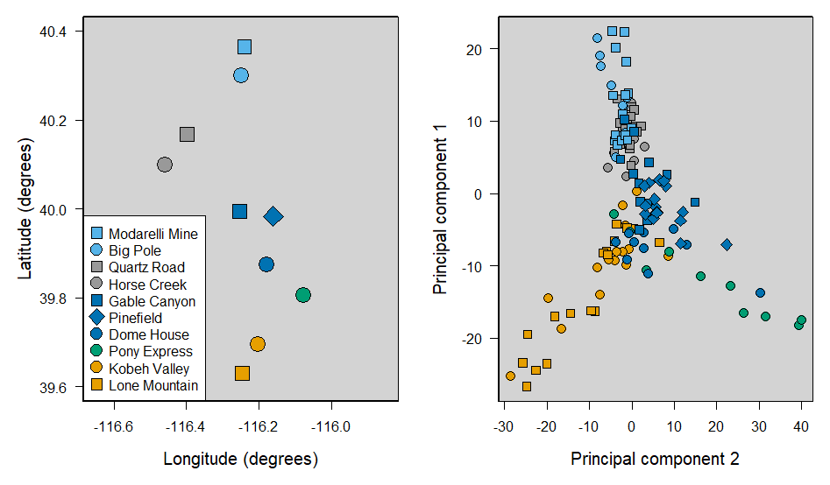
2.5-Remake
I don’t love these colors, but they are color blind friendly

